Slide 1
Ludo Game

Slide 2
Introduction
Ludo game is a board game. In free time you can play the game. 4 players can play the game at a time and at least 2 player can play the game. Each player have 4 tokens. Every player have to complete the round for each token for going to home. Which player comes to home first and complete the round for every token is the winner.

Slide 3
Purpose
In free time you can play the game and to exercise your mind

Slide 4
Functionality
New Game
About
How to play
Exit

Slide 5
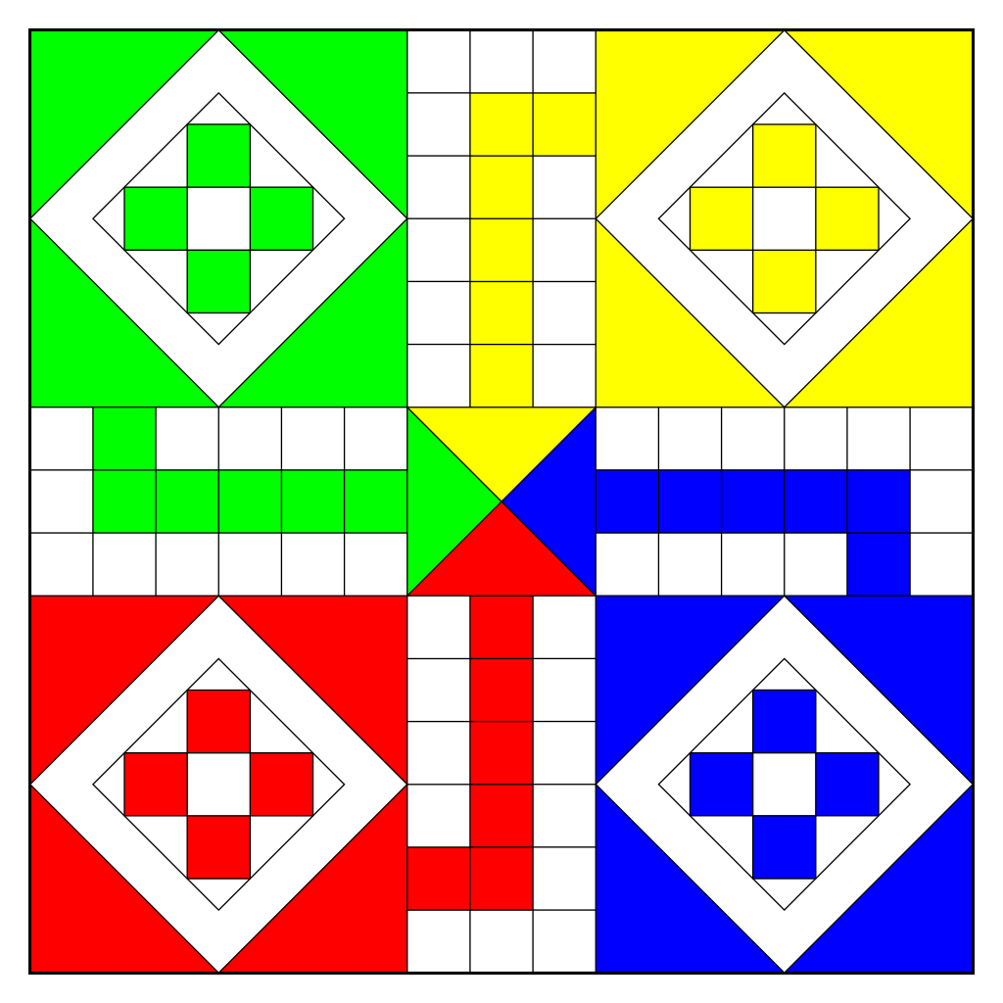






Board Design

Slide 6
Scope and Objective
Every person can play this game on andriod devices.
To Develop for Minimum 2 player and maximum 4 player that can play this game.
If only one person want to play the game then second one is robot.
To provide the best activity to users for leasure time.

Slide 7
Tools
Android Studio
Adobe Photoshop

